Slide 1
Spectral Global Intrinsic Symmetry Invariant Functions
Hui Wang
Shijiazhuang Tiedao University
Patricio Simari The Catholic University of America
Zhixun Su
Dalian University
of Technology
Hao Zhang
Simon Fraser University

Slide 2
Introduction
Global Intrinsic Symmetry Invariant Functions (GISIFs) are functions defined on a manifold invariant under all global intrinsic symmetries
Useful in shape analysis:
Critical points of GISIFs obtained via geodesic distances form symmetry invariant point sets for the generation of candidate Mobius transformations
Classical Heat Kernel Signature (HKS) Wave Kernel Signature (WKS) – both GISIFs -- are used as symmetry invariant descriptors for correspondence

Slide 3
Introduction
We propose a new class of GISIFs over compact Riemannian manifolds
Spectral method: each eigenvalue of the Laplace-Beltrami operator, either repeated or non-repeated, corresponds to a GISIF.

Slide 4
Main Related Work
M. Ovsjanikov, J. Sun, and L. Guibas. “Global intrinsic symmetries of shapes”. Computer Graphics Forum, 27(5):1341–1348, 2008.
V. G. Kim, Y. Lipman, and X. Chen. “Möbius transformations for global intrinsic symmetry analysis”. Computer Graphics Forum, 29(5):1689–1700, 2010.
Y. Lipman, X. Chen, I. Daubechies, and T. A. Funkhouser. “Symmetry factored embedding and distance”. ACM Transactions on Graphics, 29(4):439–464, 2010.

Slide 5
Background
A global intrinsic symmetry on a particular manifold is a geodesic distance-preserving self-homeomorphism.
T: M → M is a global intrinsic symmetry if for all p, q in M it holds that where g denotes geodesic distance

Slide 6
Background
A global intrinsic symmetry invariant function (GISIF) is any function f: M → R such that for any global intrinsic symmetry T it holds that f o T = f.
In other words, if for all p in M it holds that

Slide 7
Background
Some useful propositions:
Constant functions, f(p) = c for all p, are GISIFs
If f is a GISIF then c * f is a GISIF
If f and g are GISIFs, then f + g, g – f, f * g, and f/g (for g ≠ 0) are all GISIFs
Based on the above propositions, all of the GISIFs defined on a manifold form a linear space called the global intrinsic symmetry invariant function space.

Slide 8
Spectral GISIFs via the LB Operator
We propose a new class of GISIFs based on the eigendecomposition of the Laplace-Beltrami operator on compact Riemannian manifolds without boundaries.
Each GISIF corresponds to an eigenvalue, repeated or non-repeated, of the Laplace-Beltrami operator.
Formally stated…

Slide 9
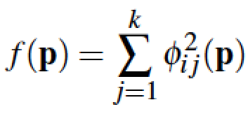
Spectral GISIFs via the LB Operator
Theorem: Suppose M is a compact Riemannian manifold without boundary, λ_{i} is an eigenvalue of the Laplace-Beltrami operator Δ on M with a k-dimensional eigenfunction space. If φ_{i1}, φ_{i2}, …, φ_{ik} is an orthogonal basis of the corresponding eigenfunction space of λ_{i}, then the function is a GISIF on M.
Discretized on meshes and point clouds (cotangent weights).
Generalizes HKS, WKS, ADF…

Slide 10
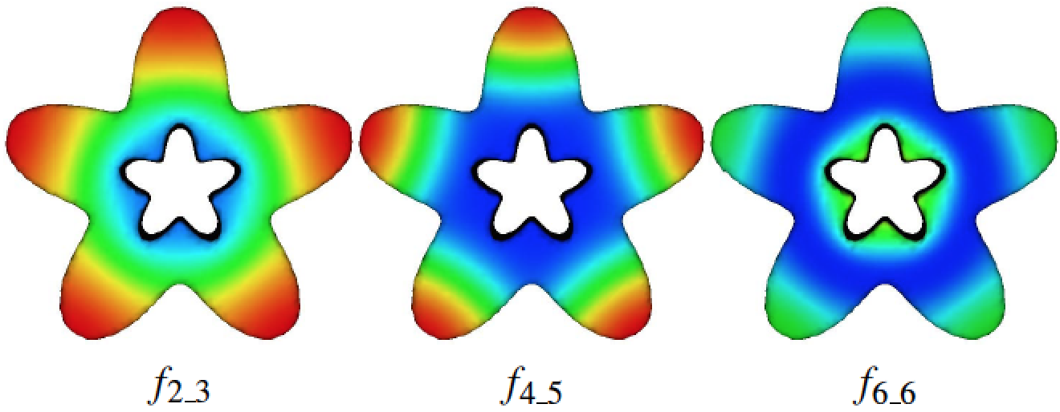
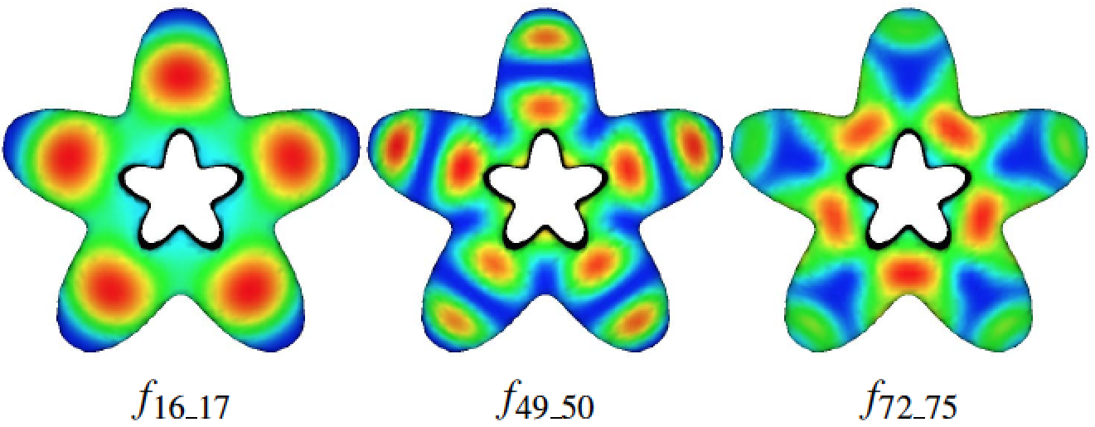
Results
Less “detail”
More “detail”
fi_j denotes a GISIF computed using eigenfunctions of the Laplace-Beltrami operator corresponding to repeated eigenvalues i through j

Slide 11
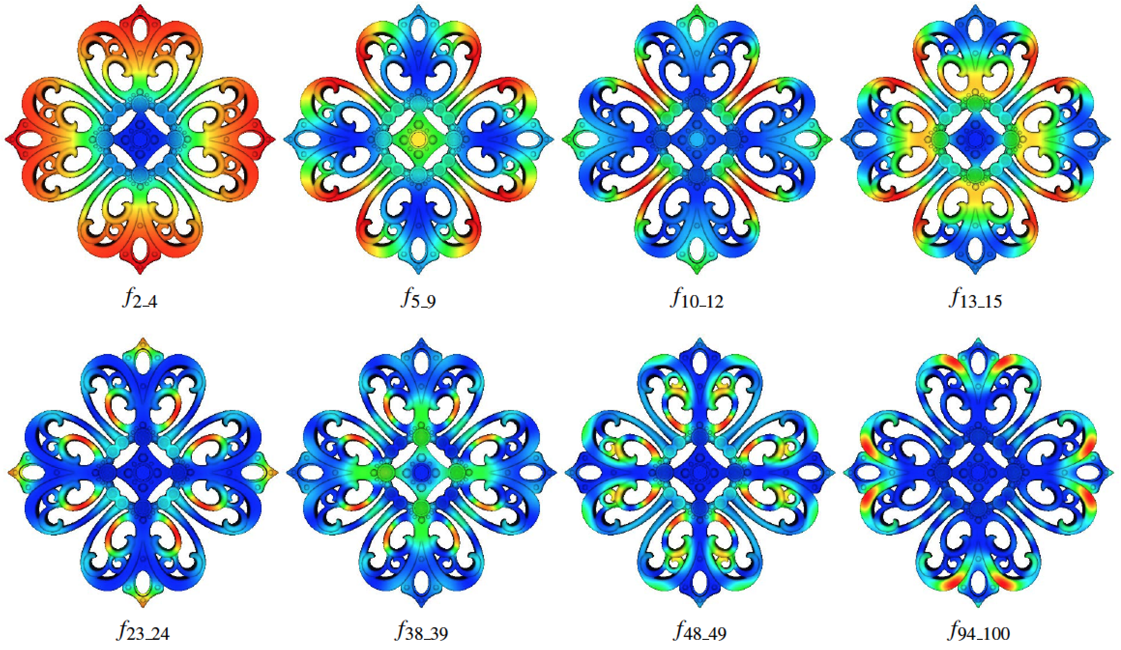
Results
fi_j denotes a GISIF computed using eigenfunctions of the Laplace-Beltrami operator corresponding to repeated eigenvalues i through j

Slide 12
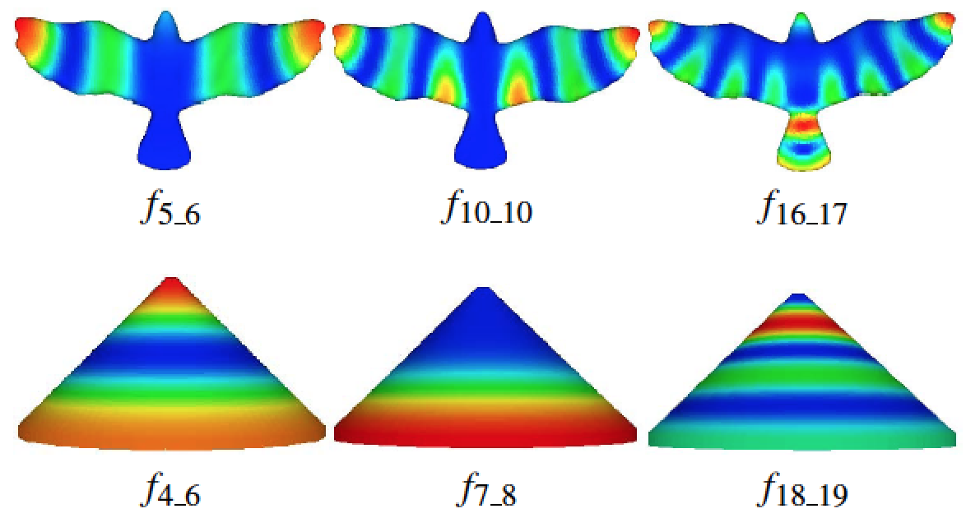
Results
fi_j denotes a GISIF computed using eigenfunctions of the Laplace-Beltrami operator corresponding to repeated eigenvalues i through j

Slide 13
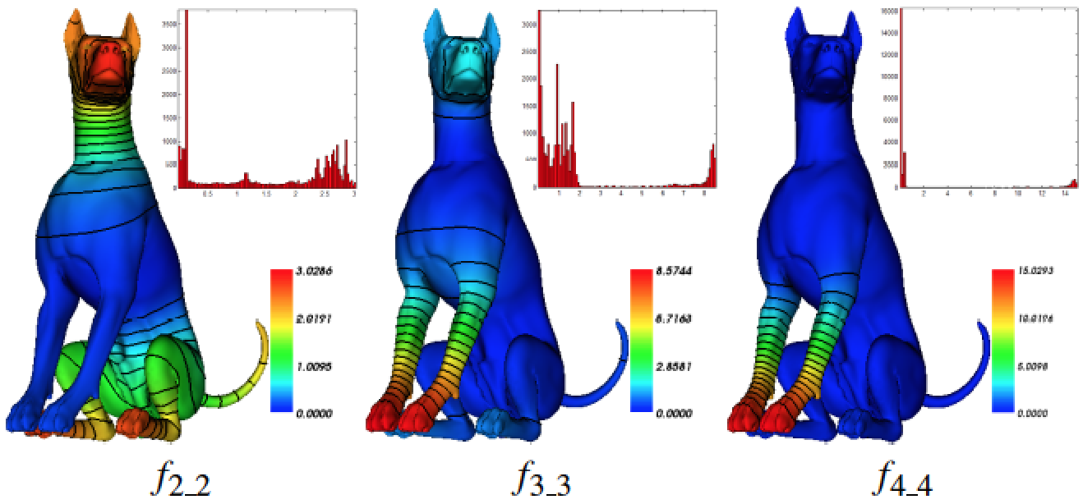
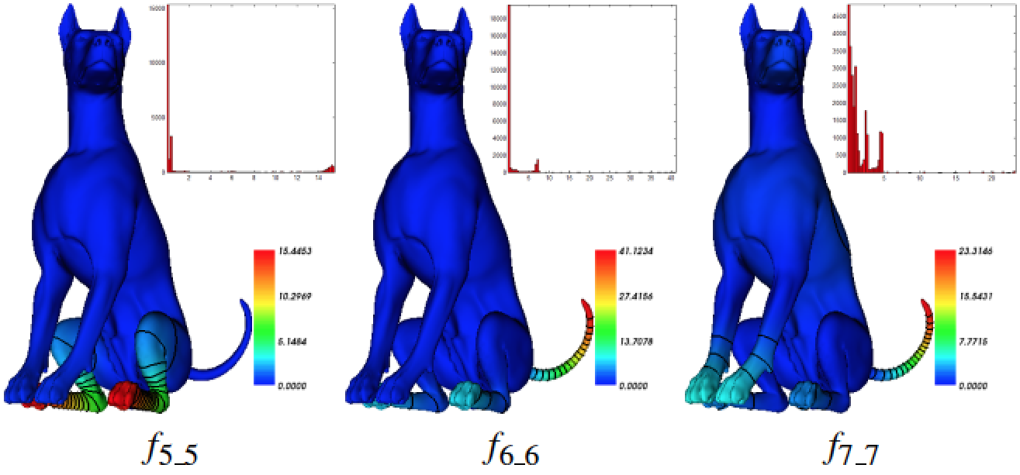
Results: Sparsity
Level sets and histograms of our spectral GISIFs. The large blue areas without contours along with the histograms of each field illustrate the sparsity of the fields.

Slide 14
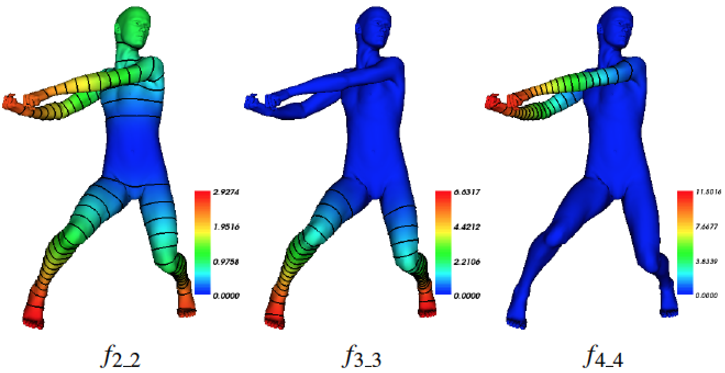
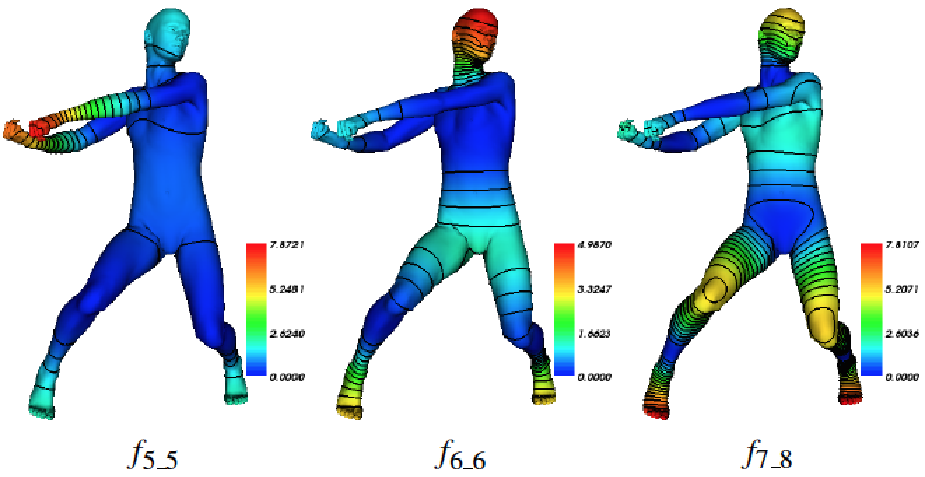
Results: Sparsity
Level sets of our spectral GISIFs. The large blue areas without contours along with the histograms of each field illustrate the sparsity of the fields.

Slide 15
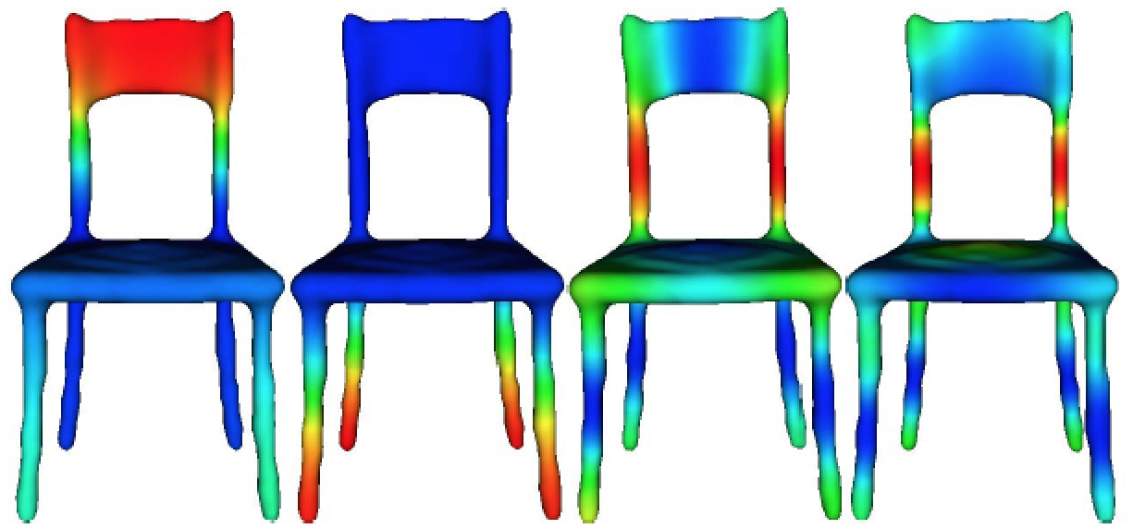
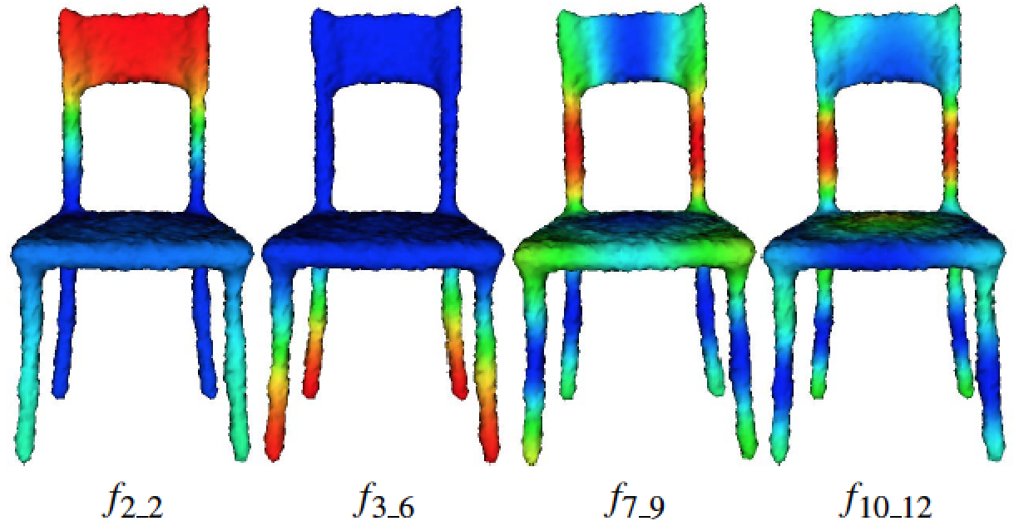
Results: Robustness to Noise
Original
Gaussian Noise: 20% mean edge length

Slide 16
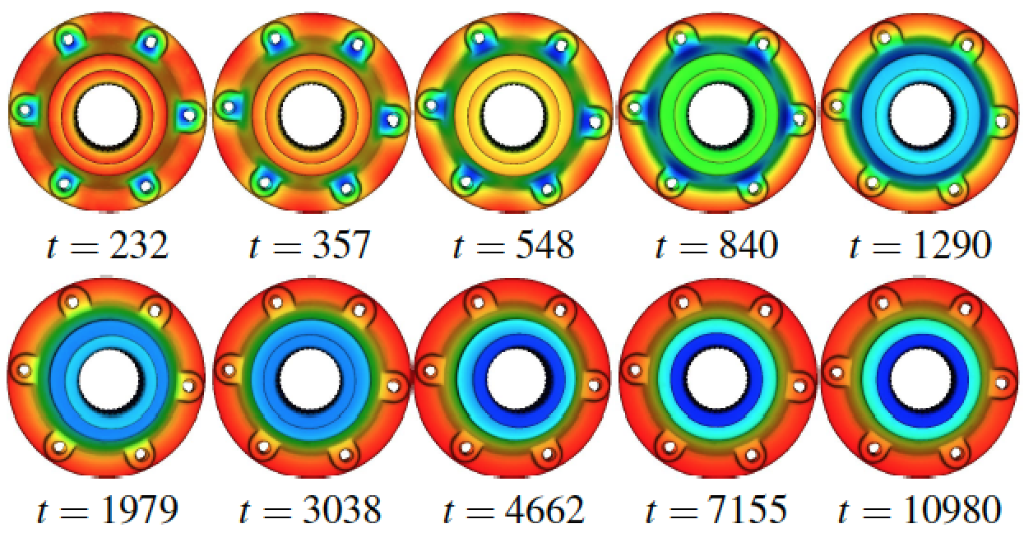
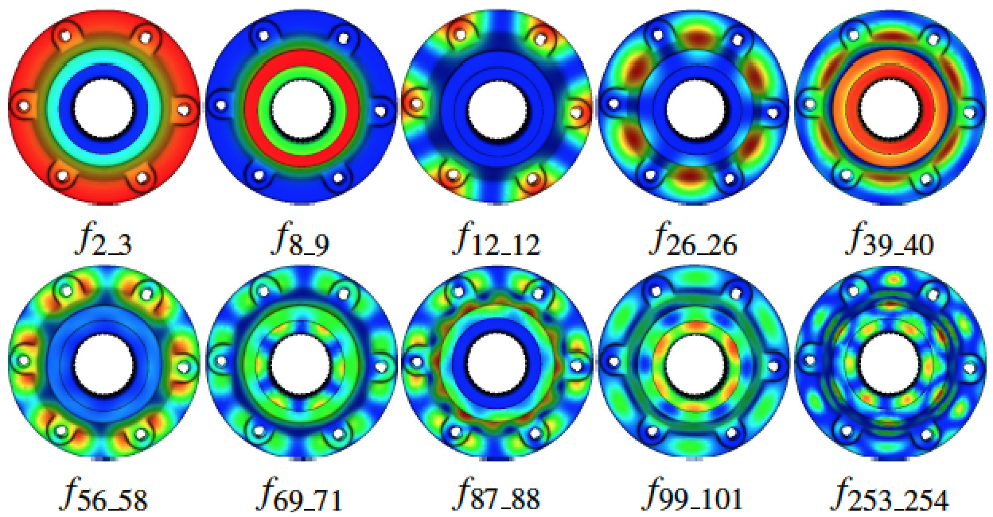
Results: Comparison to HKS
HKS for varying times (default parameters)
Some of our spectral GISIFs

Slide 17
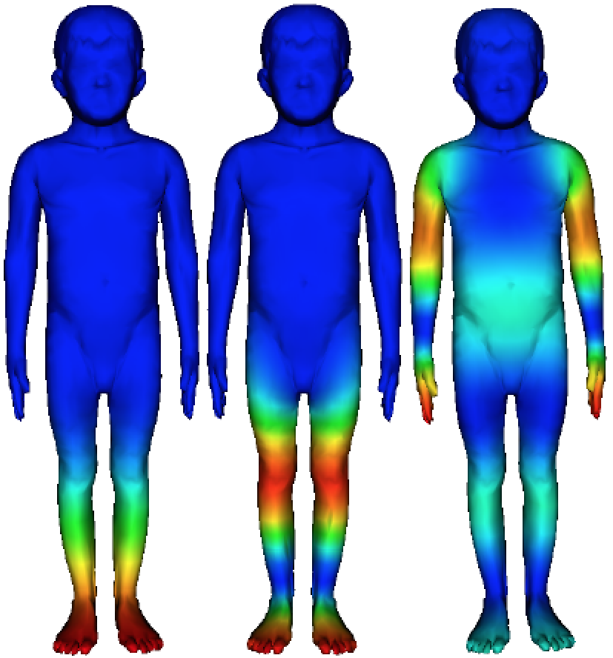
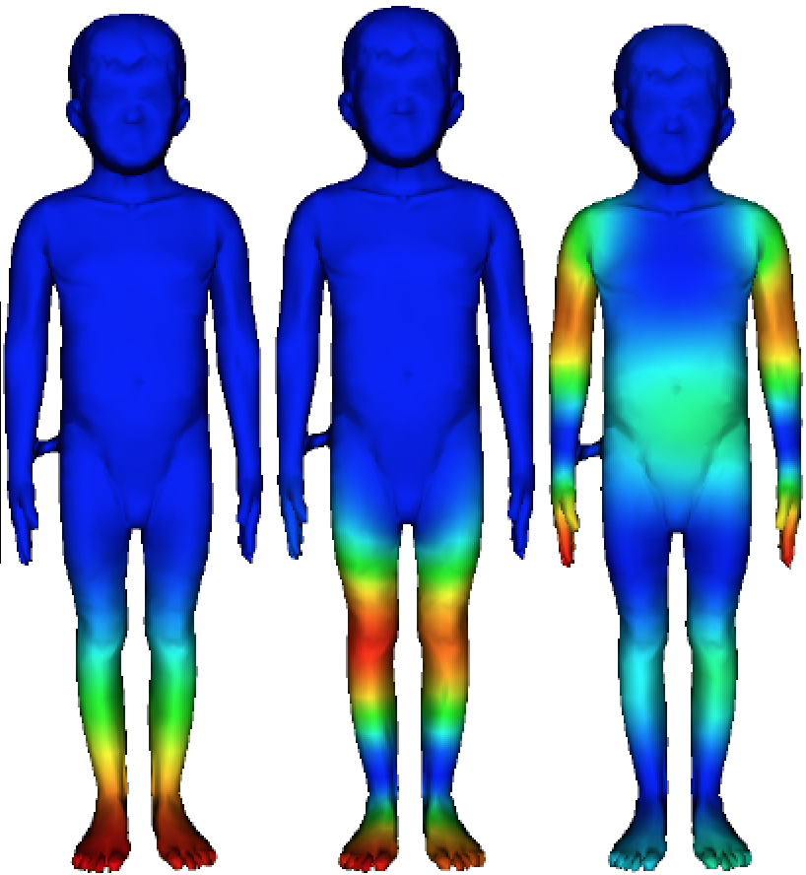
Results: Comparison to AGD
AGD
Some of our spectral GISIFs
Topological noise

Slide 18
Applications: SFDs
Symmetry Factored Embedding (SFE):
Symmetry Factored Distance (SFD):
The SFDs between a point and its symmetric points are zero.

Slide 19
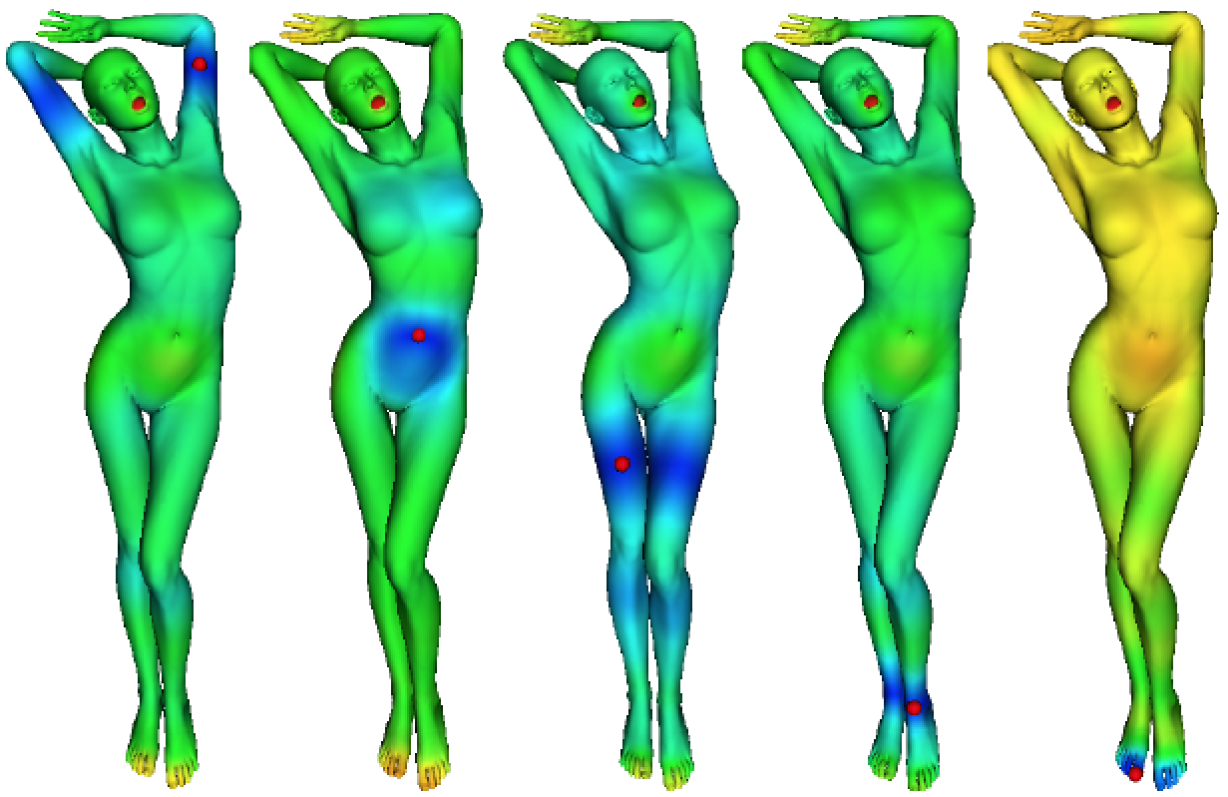
Applications: SFDs
Symmetry-factored distances (SFDs) computed using spectral GISIFs from the red points shown. Note how the SFDs between each point and its symmetric points are near zero (blue).

Slide 20
Applications: SFDs
Symmetry-factored distances from the red points
Symmetry orbits from the red points

Slide 21
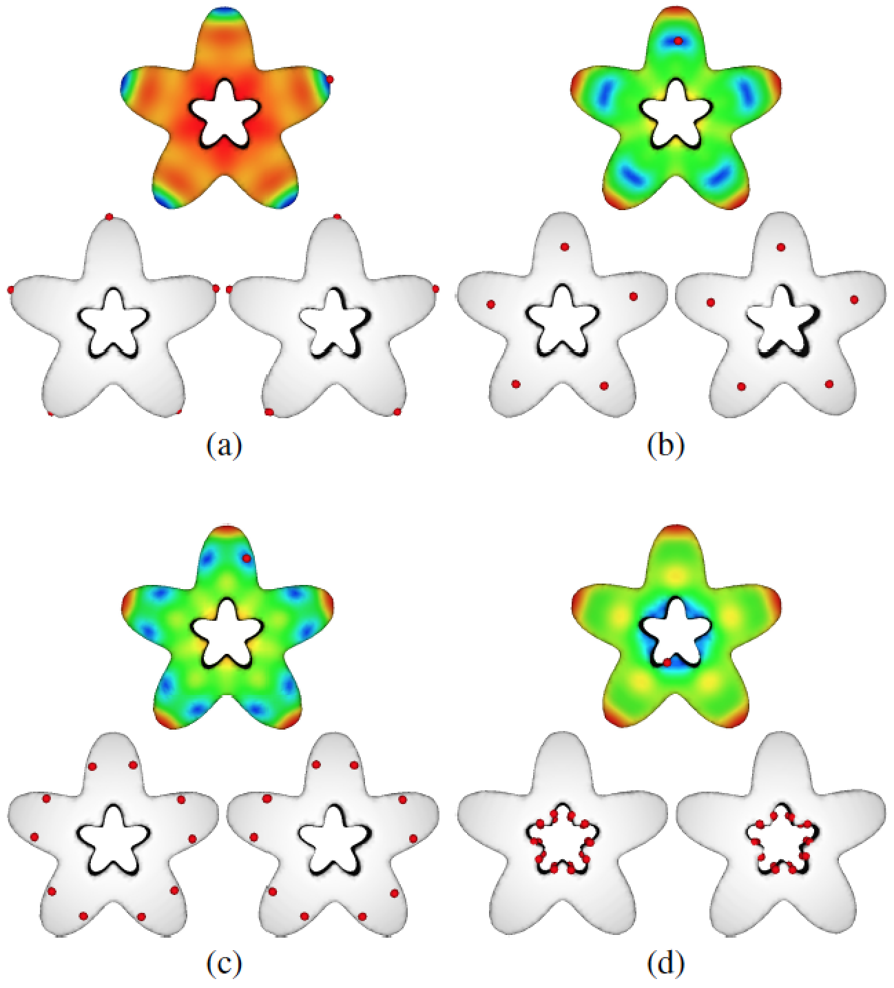
Applications: SFDs
Symmetry-factored distances from the red points
Symmetry orbits from the red points
Symmetry-factored distances from the red points
Symmetry orbits from the red points

Slide 22
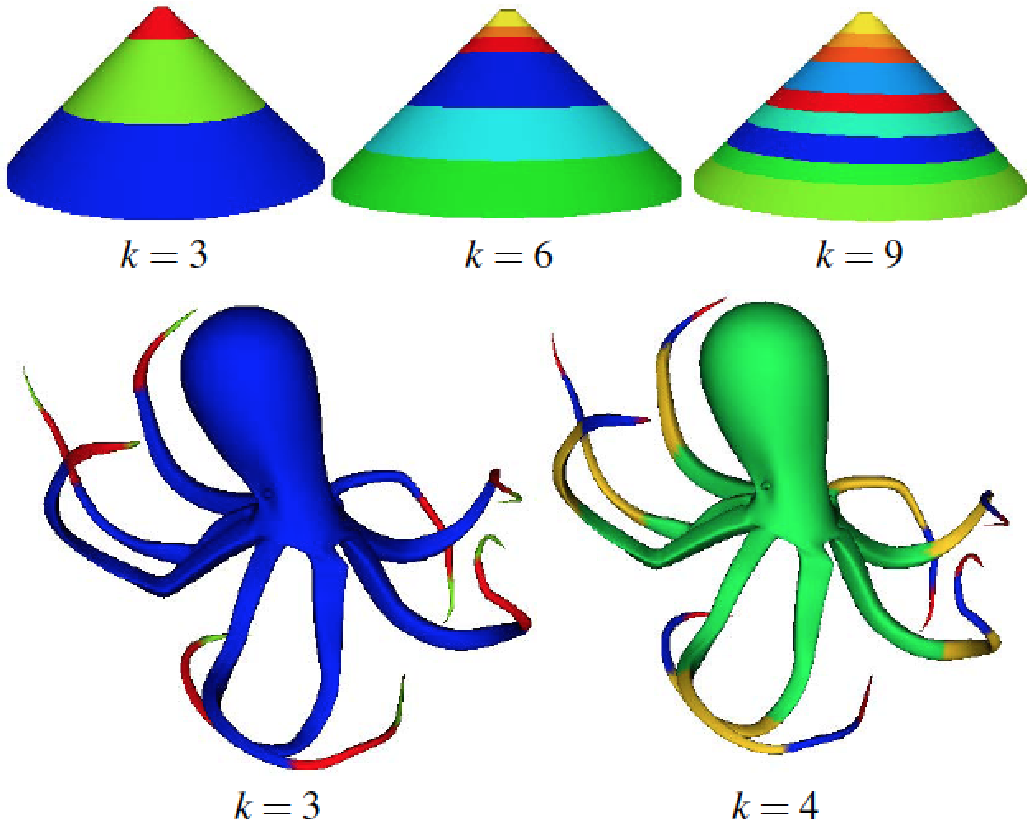
Application: Segmentation
Symmetry-aware segmentations: k-means clustering on the SFE -- preliminary result

Slide 23
Summary and Limitations
Propose a new class of GISIFs: Spectral GISIFs
More robust to topological noise than those based on geodesic distances
Generalizes HKS, WKS, ADF…
Presented applications:
Symmetry orbits
symmetry-aware segmentations (preliminary)
Limitations:
Cannot be computed on non-manifold shapes
Difficult for a user to decide which spectral GISIFs to use out of the full spectrum and if/how to combine them

Slide 24
Future Work
Theory:
Study relation between global intrinsic symmetry and multiplicity of eigenvalues of the LB operator
Formal derivation of sparsity property
Heuristics:
Choosing of most informative GISIFs (e.g., entropy)
Setting threshold for detecting repeated eigenvalue
Symmetry-aware applications:
skeletonization
texture synthesis
denoising,
repair
processing and analysis of high-dimensional manifolds

Slide 25
Thank You!

