Slide 2
Organizing Heterogeneous Scene Collections through Contextual Focal Points
Kai Xu, Rui Ma, Hao Zhang, Chenyang Zhu,
Ariel Shamir, Daniel Cohen-Or, Hui Huang
Shenzhen VisuCA Key Lab / SIAT
Simon Fraser University
National University of Defense Technology
The Interdisciplinary Center
Tel Aviv University
Notes:
Good morning everyone, the topic of our paper is about organizing collections of 3D scenes.

Slide 3
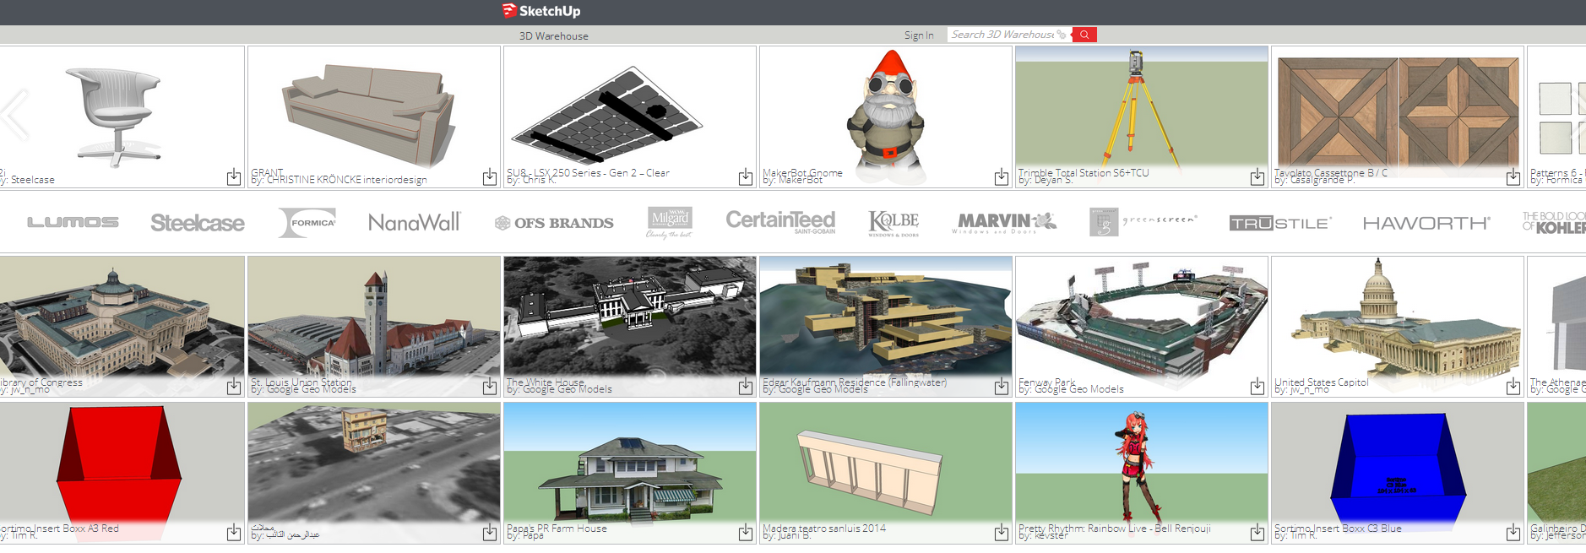
Rapid growth of 3D data
Organizing large 3D datasets
Trimble 3D Warehouse
over 2 million models
Notes:
The amount of 3D models is rapidly growing and many large repositories can be found on the Internet
A key thing to better utilizing the 3D data is to efficiently browse and explore the database
To achieve that, these 3D data should be reasonably organized,

Slide 4
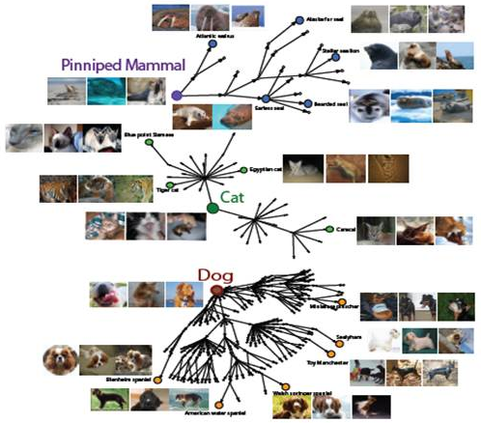
Organization
Examples
Categorization tree in ImageNet
[Stanford]
Categorization trees of 3D shape set
[Huang et al. 2013]
Notes:
Many works have been devoted to such problem,
An example is the ImageNet database where the images are organized into a categorization tree
Similar organization has been attempted for 3D shapes by Huang et al. in 2013

Slide 5
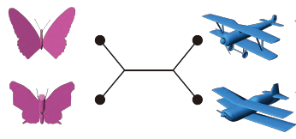
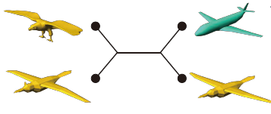
The key to organization
Grouping & relating similar contents
How to compare complex things?
For heterogeneous 3D shapes …
qualitative analysis
[Huang et al. 2013]
Notes:
Essentially, organization is to group or relate similar contents
So the key is how to compare different objects, this is esp. challenging for complex things
For example, to compare 3d models across different shape categories, qualitative analysis was employed in Huang et al.

Slide 6
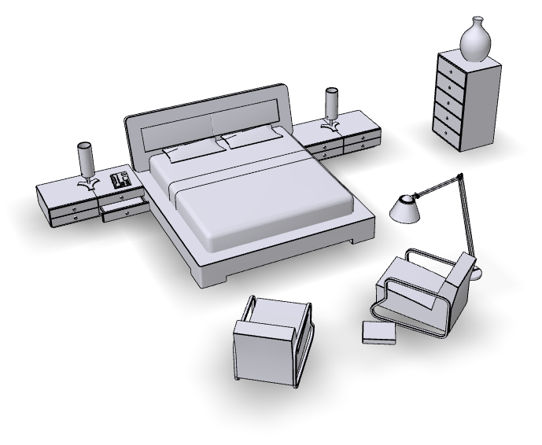
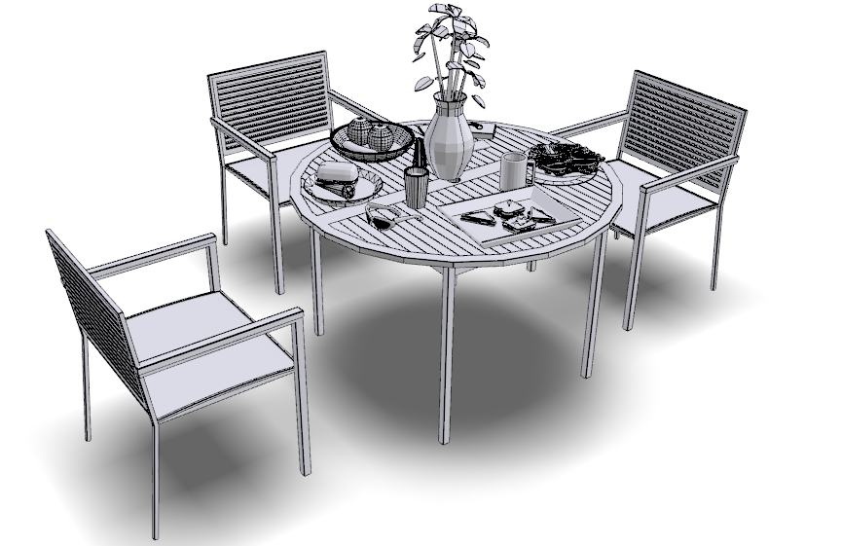
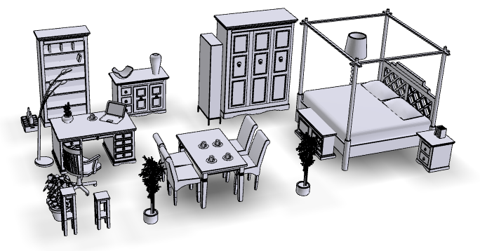
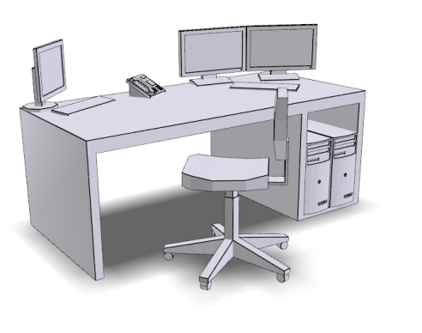
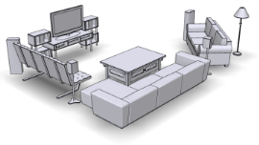
Objects vs. Scenes
bedroom
dining room
studio
living room
office
heterogeneous
hybrid
Notes:
In this paper, we look at 3D indoor scenes, which are much more complex than the individual objects therein.
And the scene collections are heterogeneous ... covering many semantic categories like bedroom, dinning room, and even hybrid scenes like a studio.

Slide 7
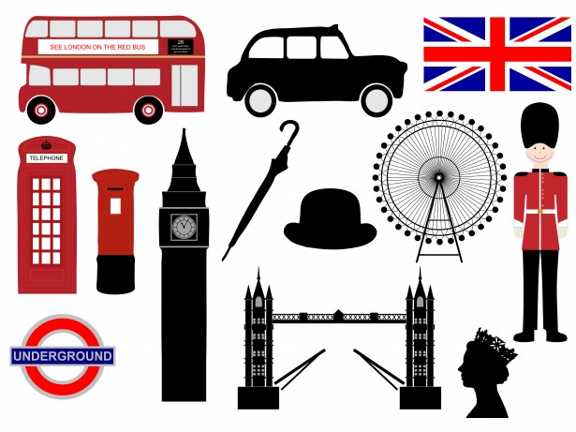
Comparing complex things
London
Paris
Notes:
To answer the question about how to compare complex things, let’s first take a look at an illustrative example,
How do you compare London and Paris? So many things come to mind so the comparison is really hard unless you have a focus.

Slide 8
Comparing complex things
New York City
Milan
London
Paris
Notes:
If we throw in New York and Milan
maybe the focus is narrowing down to the fact that they are the four fashion capitals of the world

Slide 9
Comparing complex things
Rome
Berlin
Madrid
London
Paris
Notes:
Instead, if we put in Rome, Berlin, and Madrid, the focus would switch to, they are all European capitals!

Slide 10
The key point
Comparing complex things: focal points
Determining focal points: within a context
Notes:
The key point is that when analyzing or comparing complex things, one needs focal points
and the focal points can be determined within a context.
we apply this idea to the analysis of large collections of indoor scenes.

Slide 11
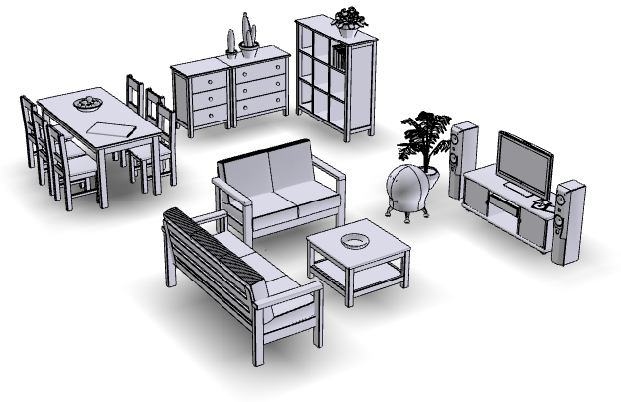
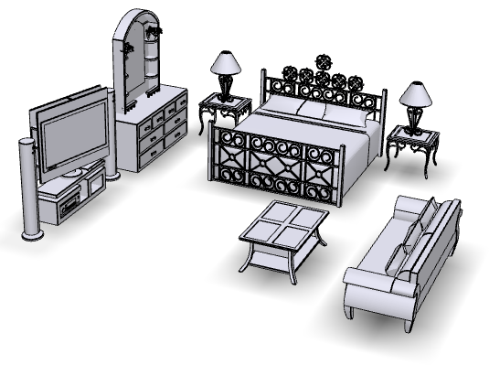
How to measure similarity of scenes?
Especially hard for hybrid scenes
distance
?
?
Notes:
To organize a scene collection, the first and foremost challenge is how to measure the similarity between the scenes

Slide 12
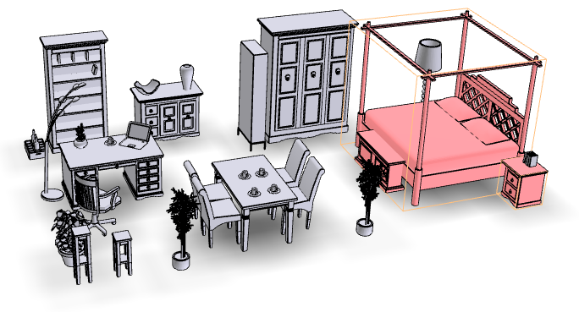
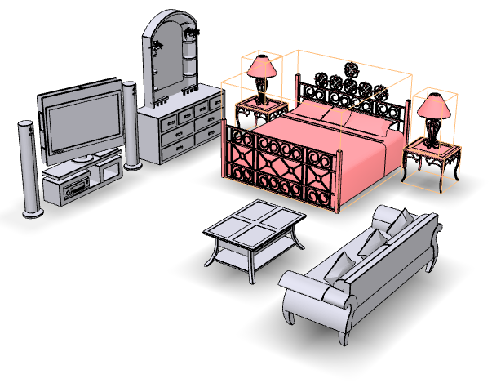
How to measure similarity of scenes
3D scenes should be compared wrt a focal point
focal : a subscene
Notes:
We advocate that 3D scenes should be compared wrt a focal point
Here a focal point is a subregion, or subscene, of the 3D scenes
For example, when bed and nightstands are focused on, it is easier for us to judge that the bottom scene is closer to the top left one

Slide 13
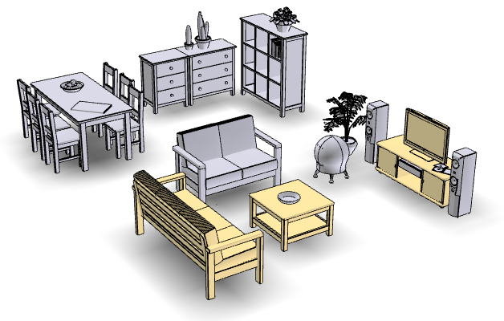
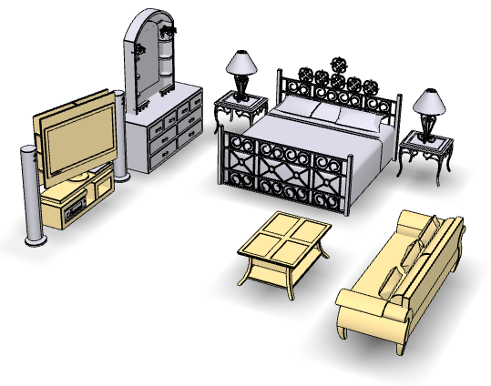
How to measure similarity of scenes
3D scenes should be compared wrt a focal point
Notes:
When the tv-table-sofa combo is the focus, the bottom scene is closer to the right one

Slide 14
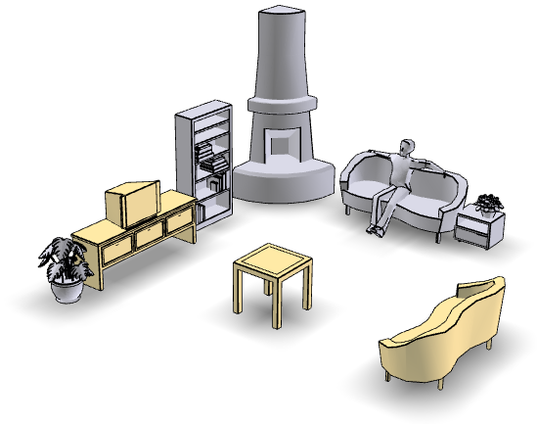
How to determine focal points?
Contextual analysis: co-analyzing a set
Characterize a semantic scene type
Frequently appear in a category
living room
… …
Notes:
Second, focal points should be determined within a context, via co-analyzing a set of scenes
Specifically, we seek for focal points as those subscenes which can characterize a semantic scene type.
For example, the tv-table-sofa combo is representative in living rooms since it appears frequently in that category

Slide 15
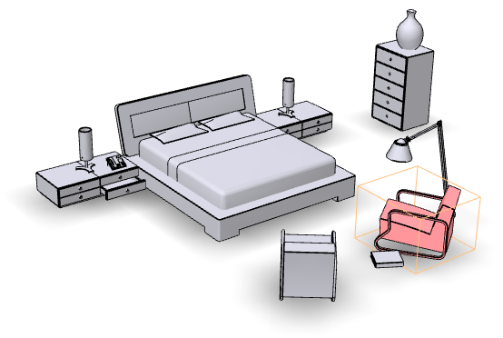
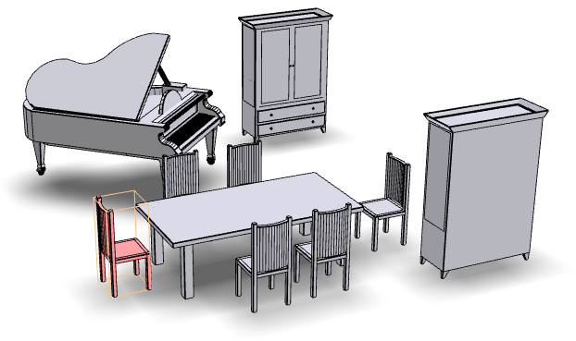
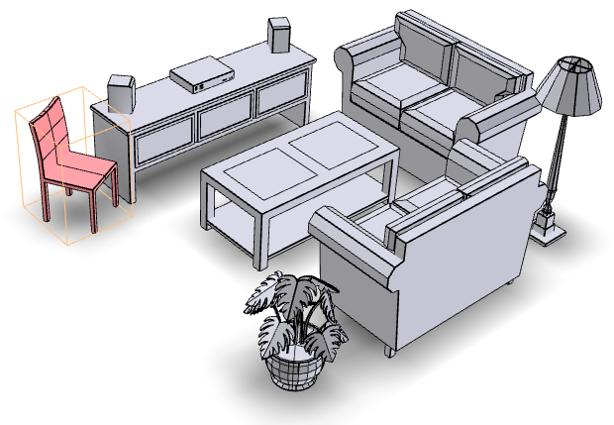
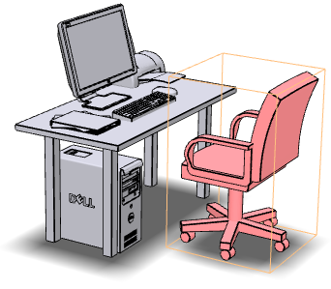
How to determine focal points?
Frequency alone is not enough …
Trivially frequent subscene is meaningless
…
a single chair may appear in most indoor scenes
Notes:
However, frequency alone is not enough..
For example, a single chair may appear in most indoor scenes,
such a trivially frequent subscene is meaningless since it does not characterize any scene type

Slide 16
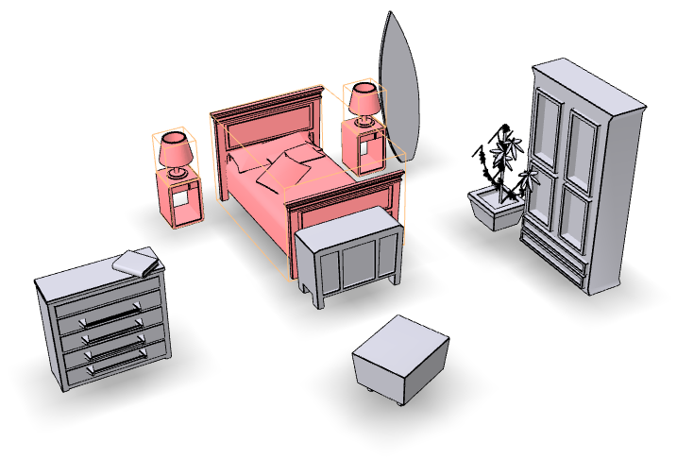
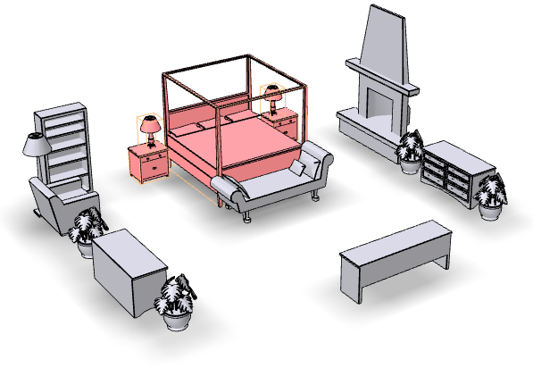
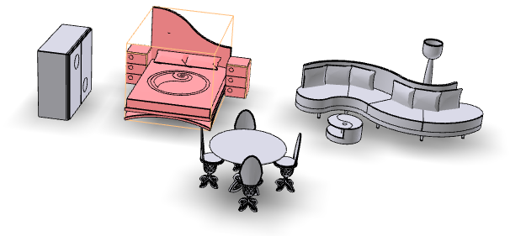
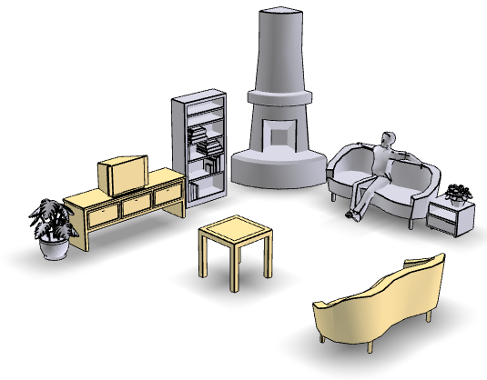
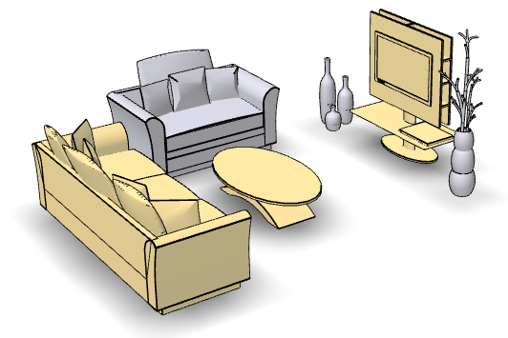
How to determine focal points?
Discriminant
Frequent only within the set of semantically related scenes
Characterize the scene category
bedroom
…
unknown
living room
…
unknown
Notes:
So what we require about focal points is not only frequent but also discriminant,
A focal point should be frequent only within the set of semantically related scenes,
so that it characterizes the corresponding scene category
However, the scene categories are unknown beforehand so we have to perform unsupervised clustering to reveal them

Slide 17
How to determine focal points?
Focal point detection relies on clustering
Frequent only within some cluster
Scene clustering is guided by focal points
Characterized by representative focal points
Coupled problems …
Notes:
So we are faced with two coupled problems,
On the one hand, focal point detection relies on meaningful clustering
On the other hand, scene clusters are characterized by their representative focal points

Slide 18
Overview
Basic rep.: structural graphs
Interleaving optimization
Notes:
Here’s an overview of our solution
First, every scene in the input collection is represented with a structural graph of the bounding boxes of scene objects

Slide 19
Overview
Interleaving optimization
Focal point detection
Focal-based clustering
Notes:
Next, we solve the coupled problems of focal point detection and focal-based scene clustering via interleaving optimization.

Slide 20
Overview
Focal-based organization
Notes:
With the detected focal points, we can perform focal-based organization of the input scene collection

Slide 21
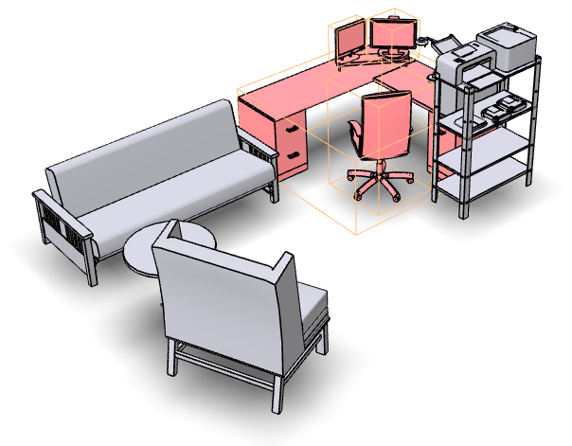
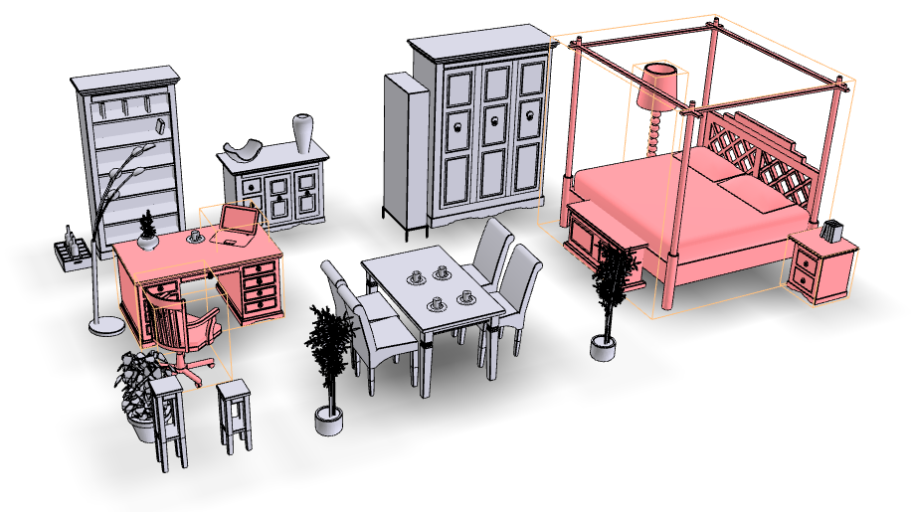
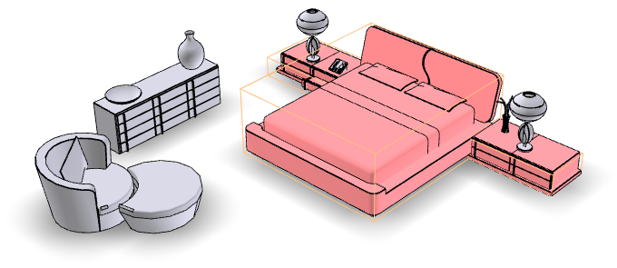
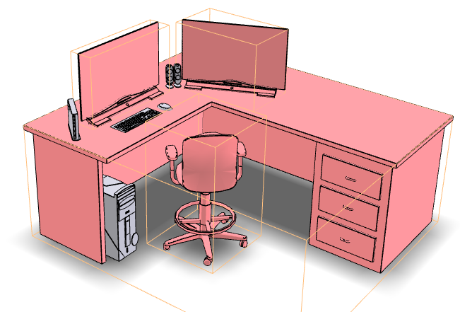
Focal-based scene collection exploration
Notes:
An interesting thing we will show is that focal points provide linkage to relate different scenes
and such linkage can facilitate exploration of scene collections

Slide 22
Main ideas
How to measure similarity of complex things?
Based on focal points
How to determine focal points?
Co-analysis of a collection
Coupled with clustering
Focal points provide a way to relate complex things
Notes:
So the major ideas in our paper are the following:
First, to measure the similarity of complex things, we propose to use focal points,
Secondly, to detect focal points, we perform co-analysis over a scene collection, which is coupled with meaningful scene clustering
Finally, the extracted focal points provides a linkage to relate the scenes which can facilitate organization and exploration

Slide 23
Outline
Datasets
Structural graph & layout similarity
Focal-driven scene co-analysis
The objective
Interleaving optimization
Notes:
Now let me hand the detailed description of our method to Rui

Slide 24
Outline
Datasets
Structural graph & layout similarity
Focal-driven scene co-analysis
The objective
Interleaving optimization
Notes:
Thanks, Kevin. So, let’s first take a look at the datasets.

Slide 25
Dataset
Collection | #Scenes | #Objects | #Scene categories | #Hybrid scenes
Stanford [Fisher et al. 2012] | 132 | 3,461 | 5 | 0
Tsinghua [Xu et al. 2013] | 792 | 13,365 | 6 | 102
Notes:
We work on two datasets, the Stanford and the Tsinghua scene repository.
As we can see, both datasets are heterogeneous (CLICK!) in terms of scene categories.
Moreover, Tsinghua dataset contains (CLICK!) 102 hybrid scenes, meaning each scene is composed of many subscenes.

Slide 26
Outline
Datasets
Structural graph& layout similarity
Focal-driven scene co-analysis
The objective
Interleaving optimization
Notes:
Then, the structural graph and layout similarity

Slide 27
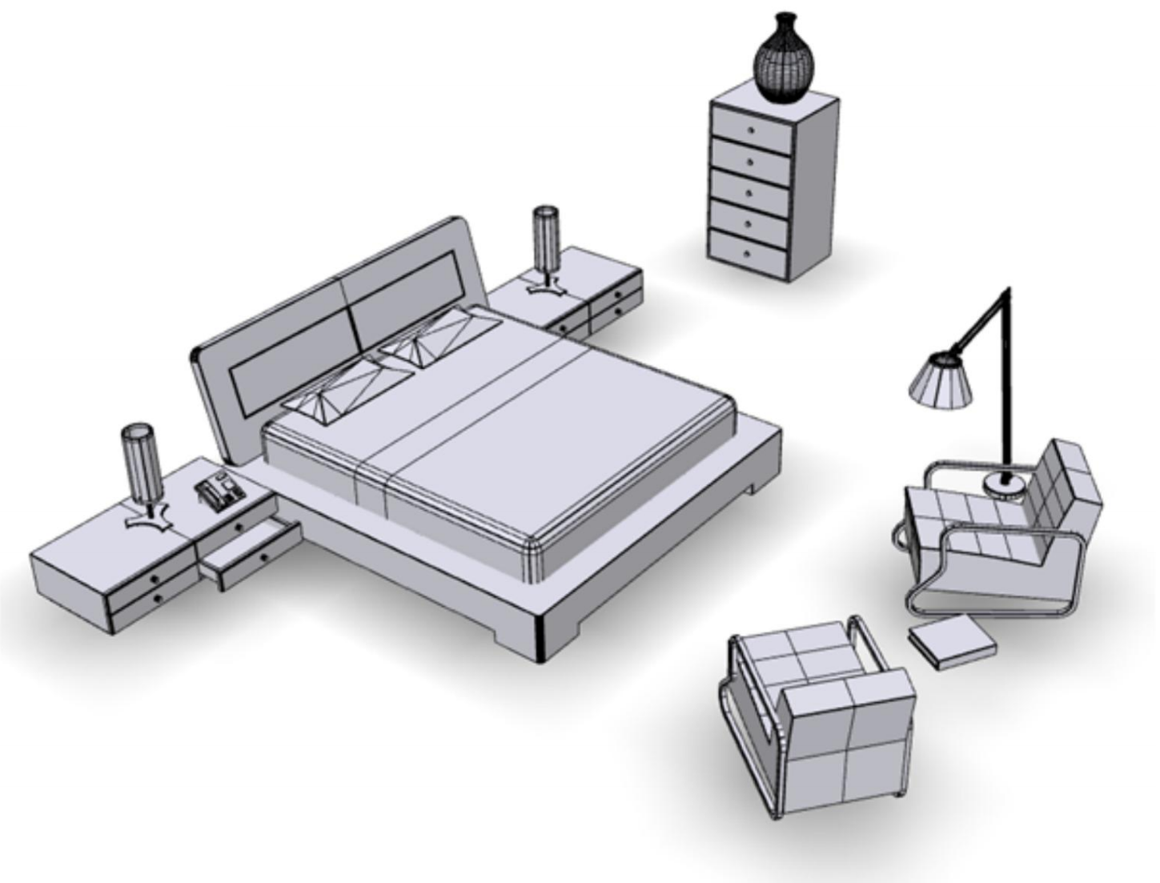
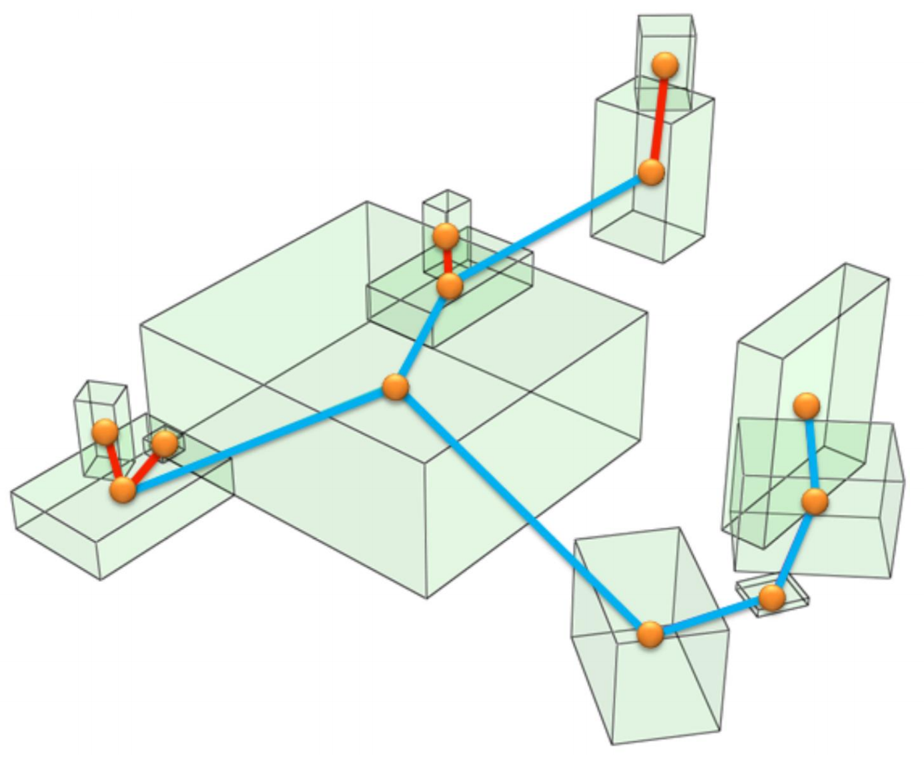
Structural graph
Nodes: individual objects
Edge: relationships (support, proximity)
Notes:
For each input scene, (CLICK!) we build a structural graph.
The nodes are scene objects abstracted by their oriented bounding boxes and
(CLICK!) the edges encode spatial relationship between objects.
We have two types of edges, support and proximity.

Slide 28
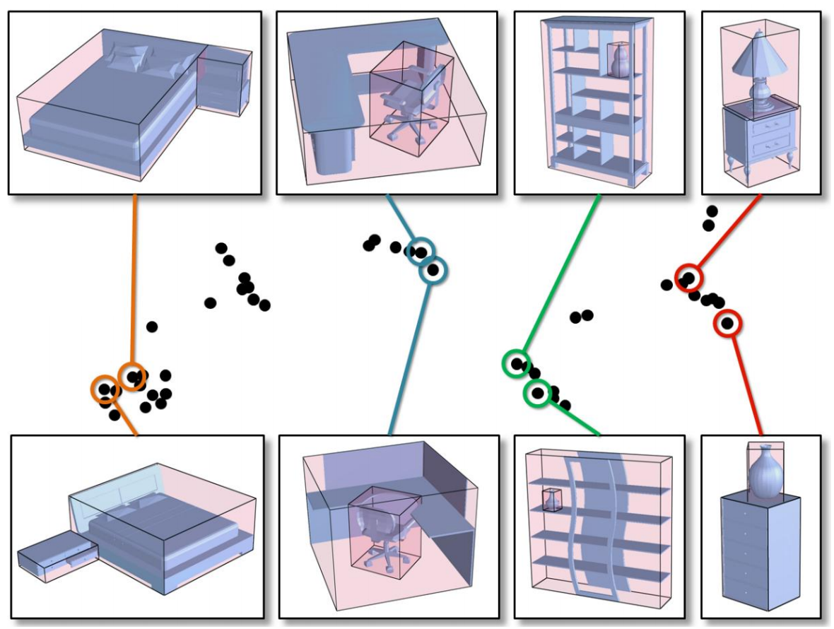
Layout similarity
Measuring edge similarity
Spatial arrangement of OBBs, not edge tags
Notes:
Layout similarity is used when measuring edge similarity.
It measures the spatial arrangement of object OBBs, instead of the edge tags.
(CLICK!) Layout similarity has a finer characterization of proximity relationships between objects,
(CLICK!) e.g. the proximity relation between the desk and chair in the figure.

Slide 29
Outline
Datasets
Structural graph & layout similarity
Focal-driven scene co-analysis
The objective
Interleaving optimization
Notes:
With these preparations, let’s go to see our focal-driven scene co-analysis.

Slide 30
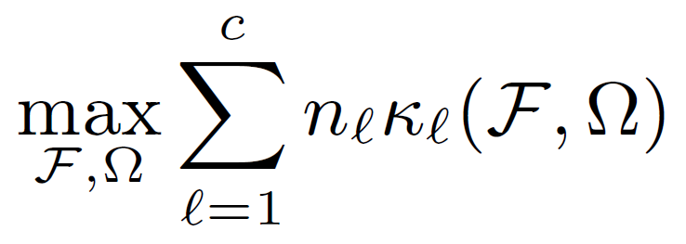
Objective
Our core problem: clustering
Objective: overall compactness of clusters
Per-cluster compactness: focal-centric scene similarity
Optimize clustering $Ω$ and focal points $F$
Notes:
Since our target is to organize the heterogeneous scene collection, our core problem is a clustering problem.
(CLICK!) The objective is to maximize the overall compactness of clusters.
(CLICK!) The term kl is the compactness of a scene cluster. It is defined by the focal-centric scene similarity measure.
(CLICK!) We aim to optimize the clustering result omega and also the extracted focal points F to get the maximum overall compactness.

Slide 31
Interleaving optimization
Focal extraction: cluster-guided graph mining
Fix clustering, optimize focal points
Scene clustering: focal-induced scene clustering
Fix focals, optimize clustering
Notes:
As we mentioned before, focal point detection and scene clustering are two coupled problems.
Here, we develop an interleaving optimization scheme.

Slide 32
Interleaving optimization
Focal extraction: cluster-guided graph mining
Fix clustering, optimize focal points
Scene clustering: focal-induced scene clustering
Fix focals, optimize clustering
Notes:
First, in focal extraction, we use the clustering result from last step to guide the graph mining.

Slide 33
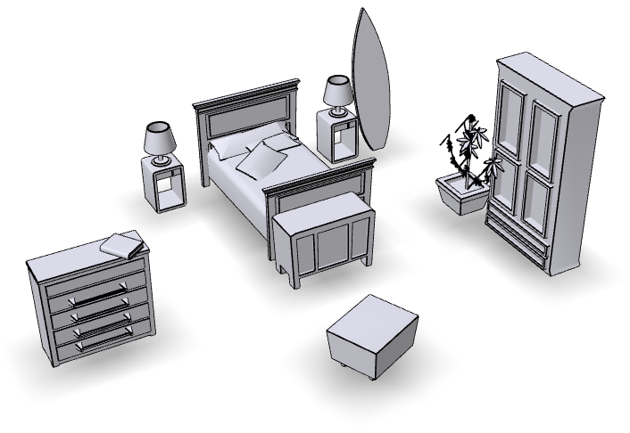
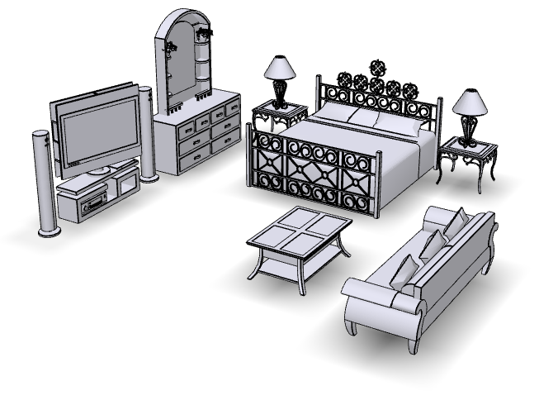
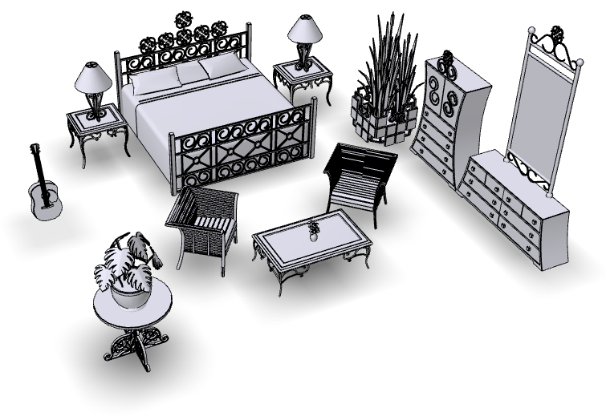
Focal extraction: graph mining
……
……
……
……
Notes:
The first goal of focal extraction is to find the frequent substructures from a scene collection.

Slide 34
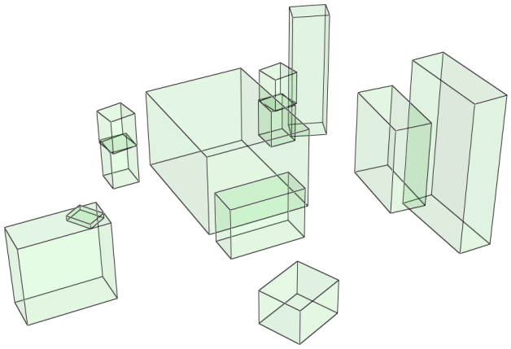
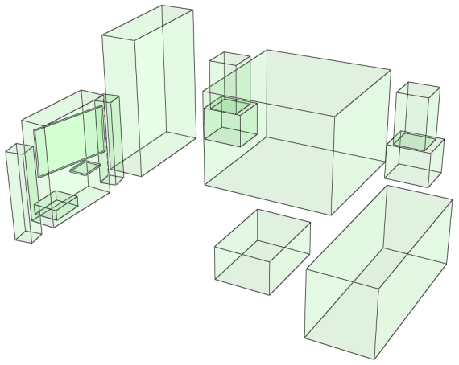
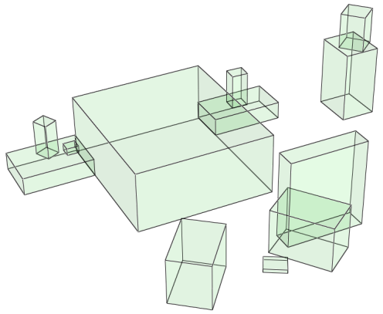
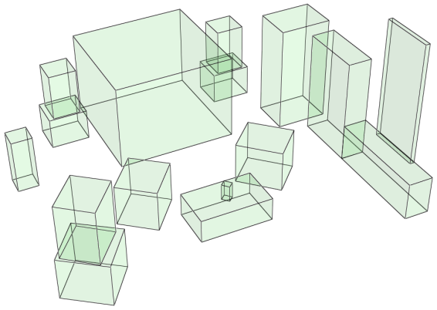
Focal extraction: graph mining
……
……
……
……
Structural graph
Notes:
By representing each scene as a graph, (CLICK!)

Slide 35
Focal extraction: graph mining
……
……
……
……
Frequent pattern mining
Notes:
we aim to find the frequent subgraphs within the set.
This can be done by frequent pattern mining.

Slide 36
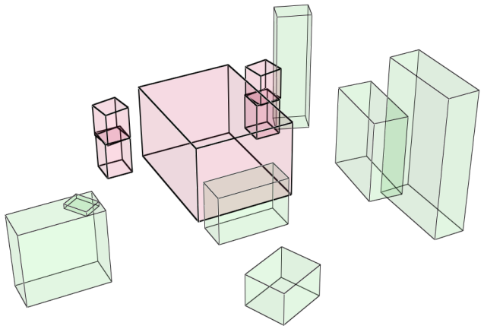
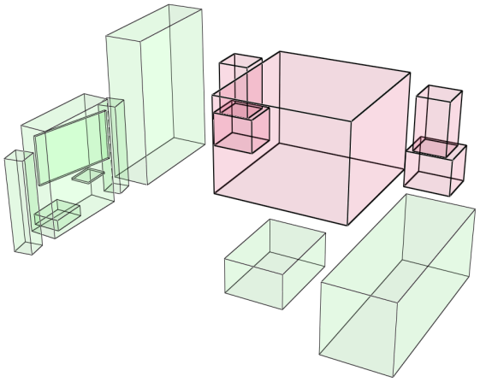
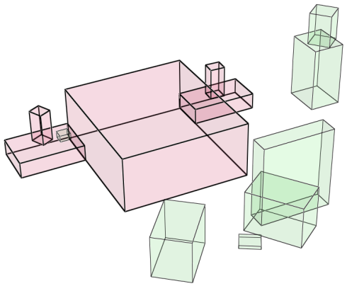
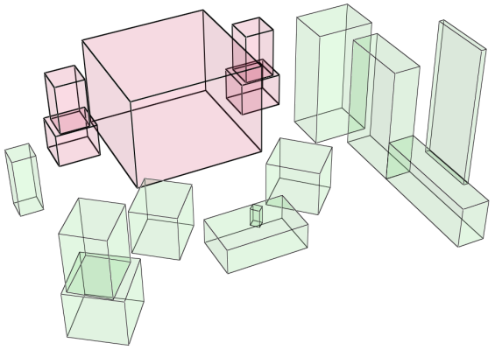
Focal extraction: graph mining
……
……
……
……
Frequent pattern mining
Notes:
Here is one frequent substructure corresponding the red subgraph in previous slide. (CLICK!)

Slide 37
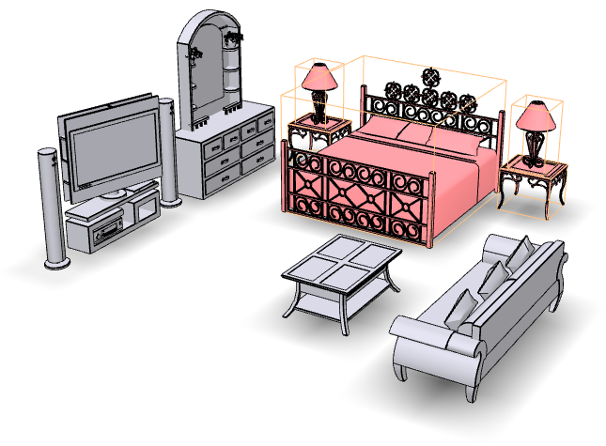
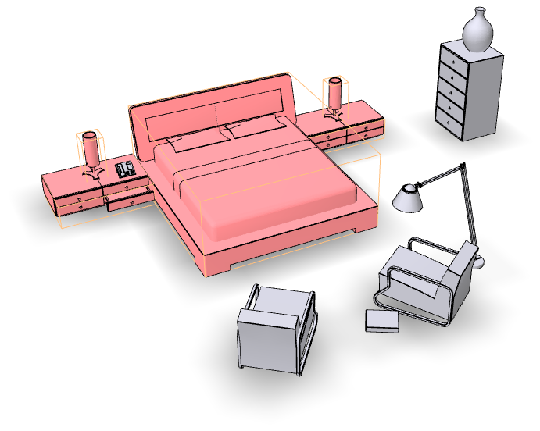
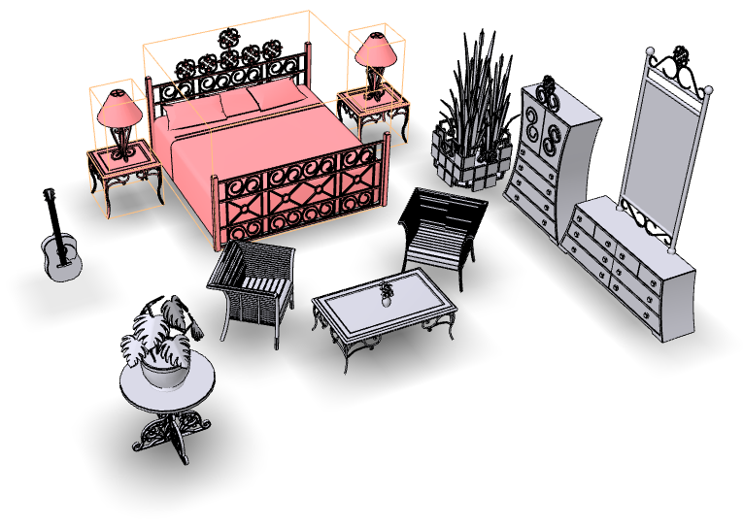
Focal extraction: graph mining
……
……
……
……
Focal embedding
Notes:
And the objects in red are the embedding of this substructure in the scenes.

Slide 38
Focal extraction: cluster-guided mining
Trivially frequent substructures
E.g. a single chair
Frequent but not discriminant
Cluster-guided mining
Mining substructures that characterize a cluster
Using clusters to weight frequency
Notes:
However, only use frequent pattern mining will produce some trivially frequent substructures.
E.g. a single chair.
Such substructures may be frequent but they are not discriminant.
(CLICK!) So, we apply the cluster-guided mining to mine substructures that do characterize a scene cluster.
(CLICK!) The idea is to use the clusters to weight the frequency of substructures instead of only counting their occurrence.

Slide 39
Cluster-guided mining: illustrative example
Total # of occurrence:
$$\# =7$$
$$\# =4$$
# $=3$
# $=3$
# $=3$
Frequent pattern mining result:
Notes:
Here is an illustrative example of our cluster-guided mining.
Each shape represents a substructure.
(CLICK!) The normal frequent pattern mining will only count the occurrence of the substructure and find the frequent ones.

Slide 40
Cluster-guided mining: illustrative example
cluster 1
cluster 2
cluster 3
Using clusters to weight frequency
Notes:
Now, suppose we already have a scene clustering result.
We use the clustering to weight the frequency.

Slide 41
Cluster-guided mining: illustrative example
cluster 1
cluster 2
cluster 3
is not discriminant
Notes:
We can find the triangle
(CLICK!) appears in all clusters
So the it is not a discriminant structure.

Slide 42
Cluster-guided mining: illustrative example
cluster 1
cluster 2
cluster 3
is representative focal of cluster 2
Notes:
Also, we can find the square
(CLICK!)only frequently appears in cluster 2, so it will be the representative focal of this cluster.

Slide 43
Cluster-guided mining: illustrative example
cluster 1
cluster 2
cluster 3
Cluster-guided mining result:
Notes:
At last, we take the union of representative focals
of each cluster as the result of our cluster-guided mining step.

Slide 44
Interleaving optimization
Focal extraction: cluster-guided graph mining
Fix clustering, optimize focal points
Scene clustering: focal-induced scene clustering
Fix focals, optimize clustering
Notes:
The next step of our interleaving optimization is focal-induced scene clustering

Slide 45
Scene clustering
Representation: Bag-of-Word (BoW) feature
$$x( )$$
$$1$$
$$1$$
$$0$$
$$0$$
$$0$$
$$x( )$$
$$1$$
$$0$$
$$1$$
$$0$$
$$0$$
$$x( )$$
$$0$$
$$0$$
$$1$$
$$0$$
$$1$$
Notes:
We represent each scene by a bag-of-word feature.
The initial feature is an indicator vector showing whether the scene contains a certain focal or not.
We will use this mini dataset to show the general idea of our scene clustering.

Slide 46
Scene clustering
Subspace clustering [Wang et al. 2011]
$$x( )$$
$$x( )$$
$$x( )$$
Notes:
To be convenient, we represent these indicator features using the grey color.
(CLICK!) Directly apply subspace clustering from Wang et al 2011, we will get two clusters.

Slide 47
Scene clustering
Indicator feature: not very informative
$$x( )$$
Really similar?
$$x( )$$
$$x( )$$
Notes:
However, since the indicator features only capture the occurrence of the focals, and they are not very informative to reflect the actual scene similarity.
The question is, although scene 1 and scene 2 both have the triangle, (CLICK!) are they really similar? What if the triangle is a trivial structure?

Slide 48
Focal-induced scene clustering
Per-cluster compactness defined by focal-centric graph kernel (FCGK):
FCGK
Root walk kernel
[Fisher et al. 2011]
Scaling factor
Notes:
To capture the actual scene similarity, we define the compactness of a cluster as the average distance between all pairs of structural graphs belonging to this cluster.
(CLICK!) The graph distance kG is defined by focal centric graph kernel.
The general idea is to emphasize the role of focals in scene comparison.
(CLICK!) This is done by adding a scaling factor lamda to the original graph kernel model from Fisher et al. 2011
The nodes belonging to the representative focals will have a large scaling factor.

Slide 49
Focal-induced scene clustering
Reweight Bag-of-Word feature
Overall Comp.: 1.2
$$x( )$$
Comp.: 0.2
$$x( )$$
$$x( )$$
Comp.: 1.0
Notes:
So, with the clustering result from last step, we first compute the compactness (CLICK!) of each cluster
and then re-weight (CLICK!) the bag-of-word feature.

Slide 50
Focal-induced scene clustering
Reweighted subspace clustering
Overall Comp.: 2.8
$$x( )$$
Comp.: 1.0
$$x( )$$
$$x( )$$
Comp.: 1.8
Notes:
Apply the subspace clustering to the reweighted features and we will get a new clustering result.
(CLICK!) Note now scene 2 is clustered with scene 3 due to the square.
And the overall compactness also increases.

Slide 51
Interleaving optimization
Objective: maximize overall compactness
Notes:
In summary, our optimization is interleaving with cluster-guided graph mining and focal-induced scene clustering.
The objective is to maximize the overall compactness of the clusters.

Slide 52
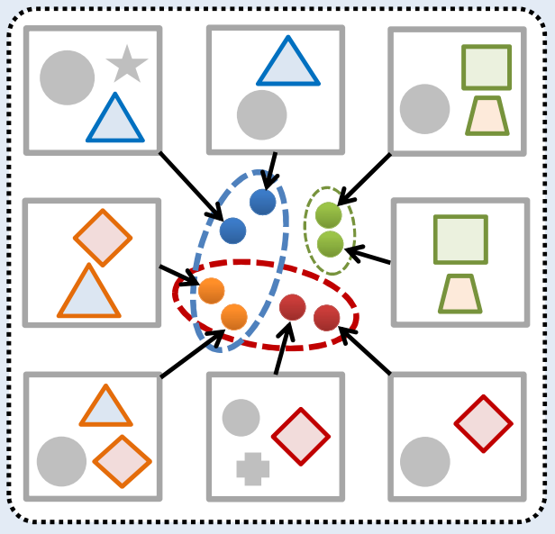
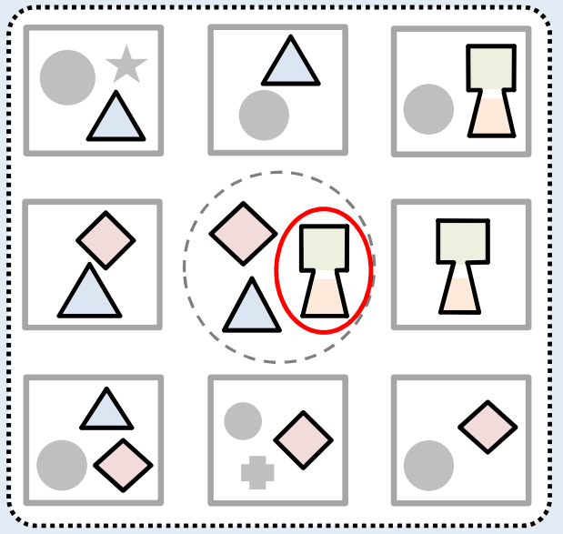
Post-processing
Cluster attachment
Focal joining
Cluster overlap
Large-scale and non-local focals
Notes:
To further improve the clustering result. We perform two post-processing steps.
(CLICK!) The first one is cluster attachment.(CLICK!) Here scenes in orange cluster have multiple focals; these scenes are typically hybrid scenes.
they are attached to both the blue and the red cluster to reveal the cluster overlap.
(CLICK!) The other step is focal joining.(CLICK!) In the green cluster, since the square and trapezoid co-appear in all scenes of the cluster, we join them together to form a larger and non-local focal .

Slide 53
Co-analyzing scene collection
Notes:
Here is a demo of our focal-driven scene co-analysis.
The input is a collection of heterogeneous scenes.

Slide 54
Notes:
The interleaving optimization simultaneously extract focal points and cluster the scenes based on focal centric distance measure.
Here we can see the representative focals highlighted in each cluster.

Slide 55
Results
Collection | Time (min) | #Focal | #Non local focal | %Multi-focal scenes
Stanford (132) | 3.2 | 24 | 4 | 50.4%
Tsinghua (792) | 10.5 | 34 | 7 | 46.1%
Time
focal point extraction (~5%)
scene clustering (~90% with a Matlab implementation)
Notes:
Here is some statistics of the results.
It takes about 3 and 10 mins for the two datasets.
As we can see almost (CLICK!) half of the scenes in both datasets have multiple focal points detected.
We also identify the (CLICK!) non-local focals thanks to the focal joining step.

Slide 56
Compactness Plot
Change of overall compactness while interleaving optimization
Stanford
Tsinghua
Notes:
These two plots are the overall compactness change during the interleaving optimization.
The red dots(CLICK!) represent the switching points from the mining step to the clustering step.
From the curve, we can see although the change is not strictly monotone, the iteration does generally improve the compactness over time.

Slide 57
Detected focal points (Tsinghua)
……
Non local focals
Notes:
These are some focal points detected by our method
These focals are both frequent in the dataset and also discriminant to represent a scene type.
(CLICK!) Also, note that we can detect non-local focals like the tv-table-sofa combo

Slide 58
Results – Comparing to graph kernel [Fisher et al. 2011]
FCGK is more discriminative;
New perspective to compare complex scenes
Notes:
Comparing to graph kernel, our focal-centric graph kernel is more discriminative; it provides a new perspective to compare complex scenes.
(CLICK!) For example, for these two rooms, since the overall structures are similar, graph kernel will get a small distance while focal-centric graph kernel will get a larger one when choosing the red objects as focals.

Slide 59
Application – Comprehensive retrieval
……
Query
Notes:
A new application enabled by our focal centric similarity measure is the comprehensive retrieval.
Here, we first find two focals (CLICK!) in the query scene by matching with focals in the dataset.
(CLICK!) Then, the results will be multiple ranked lists retrieved depending on different focals used, as highlighted in the right figures.

Slide 60
Application – scene collection exploration
“gateway”
Notes:
With our scene organization and extracted focals, we can explore the scene collection through the focals that interlink them.
Those hybrid scenes (CLICK!) which have multiple focals serve as a linkage or a gateway between these scene clusters
So we can transit between scene categories during the exploration, here, from the bedroom to the office.

Slide 61
Limitations
Use object labels:
Handling of noisy or incomplete labels?
Pure geometry analysis?
Structural graphs model flat arrangements of objects
Hierarchical organization potentially advantageous?
Notes:
One limitation of our work is the algorithm depends on the semantic labeling of scene objects.
It remains to be seen whether it can handle noisy or incomplete labels based on pure geometry analysis.
(CLICK!) Another limitation is our structural graphs only model flat arrangements of objects.
Hierarchical organization may be potentially advantageous.

Slide 62
Future work
Apply to other datasets
E.g. large and heterogeneous collections of images
Scene synthesis
Substitute sub-scenes instead of one object at a time
Notes:
Future work, one obvious pursuit is to apply our focal-driven approach to other datasets,
e.g. large and heterogeneous collections of images
(CLICK!) Another possibility enabled by our scene organization and focal-based scene retrieval is to perform scene synthesis by substituting sub-scenes instead of one object at a time.

Slide 63
Acknowledgement
Anonymous reviewers
Datasets: [Fisher et al. 2012] and [Xu et al. 2013]
Research grants:
NSFC China, NSERC Canada, National 863 Program of China, Shenzhen Innovation Program, CPSF China, Israel Science Foundation
Notes:
At last, thanks to the reviewers, the authors of the two datasets, and also our research grants for supporting our work.

Slide 64
Thank you!
An exploratory path through an overlap smoothly transits between two scene clusters.

